Slide 1
Branch and Bound

Slide 2
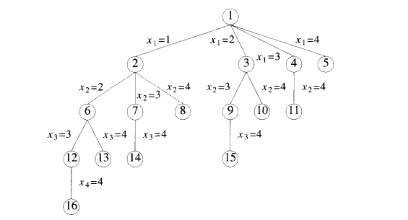
Branch and Bound -Terminology
BREADTH-FIRST-SEARCH : Branch-and Bound with each new node placed in a queue .The front of the queen becomes the new E-node.

Slide 3
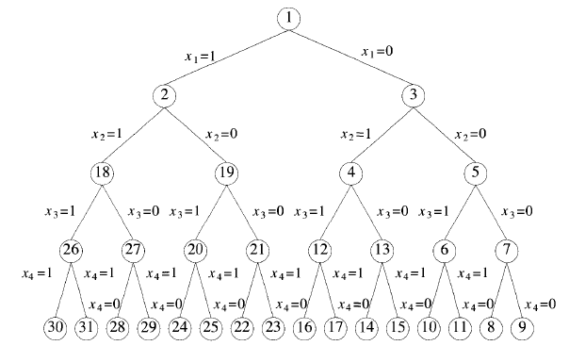
Branch and Bound -Terminology
DEPTH-SEARCH (D-Search) : New nodes are placed in to a stack.The last node added is the first to be explored.

Slide 4
Branch and Bound Principal
The term branch-and-bound refers to all state space search methods in which all children of the £-node are generated before any other live node can become the £-node.
We have already seen two graph search strategies, BFS and D-search, in which the exploration of a new node cannot begin until the node currently being explored is fully explored.
Both of these generalize to branch-and-bound strategies.
In branch-and-bound terminology, a BFS-like state space search will be called FIFO (First In First Out) search as the list of live nodes is a first-in-first-out list (or queue).
A D-search•like state space search will be called LIFO (Last In First Out) search as the list of live nodes is a last-in-first-out list (or stack)

Slide 5
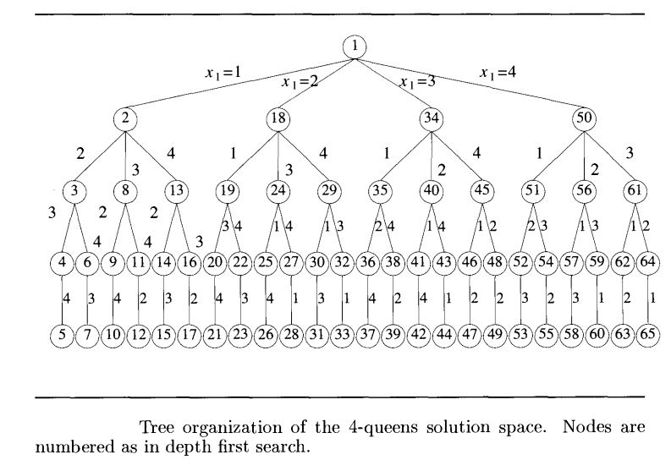
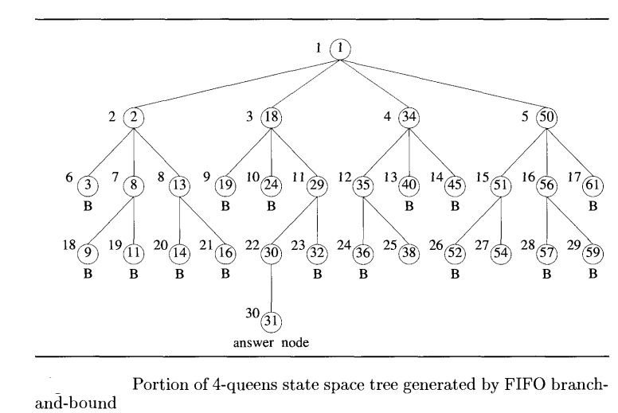
Drawback with FIFO and LIFO branch and bound
Selection rule for the next E-node depends on data structure
Does not give preference to a node that has a very good chance of getting the search to an answer node quickly
How to find the answer node quick

Slide 6

Least Cost Branch and Bound(LCBB)
The search for an answer node can often be speeded by using an "intelligent" ranking function, , for live nodes. The next E-node is selected based on ranking function
How to assign rank for each node ?
For a node x,
the number of nodes in the subtree ‘x’ that need to be generated before an answer node is generated.
the number of levels the nearest answer node (in the subtree ‘x’) is from ‘x’ .
But in both approaches to calculate the cost of node ‘x’ we need to search the subtree ‘x’ for the answer node .
Hence, by the time the cost of a node is determined, that subtree has been searched and there is no need to explore ‘x’ again.
Search algorithms usually rank nodes only on the basis of an estimate of their cost.

Slide 7



Least Cost Branch and Bound(LCBB)
Additional effort needed to reach an answer node from x
Effort done to reach ‘x’ from root node
Node which is having least cost will be the next E-node
Two Special cases can be drawn from LC search
If =0 and = level of node ‘x’, then LC search generates nodes by levels. Nothing but BFS-search or FIFO -search
or LIFO -search

Slide 8
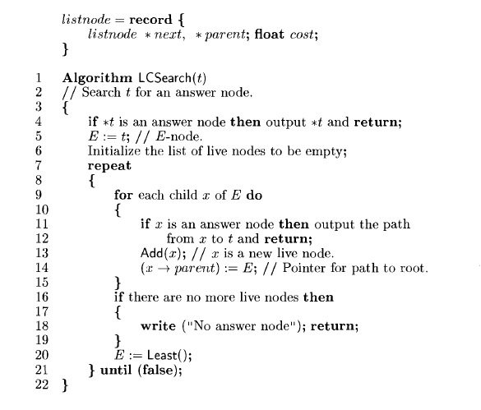
Control Abstraction for LC -Search

Slide 9
Problem with the FIFO,LIFO and LC Search
Generated all the nodes.
Terminate in a finite state space tree which is having an answer. And process all the nodes in a finite state space tree which does not have a solution.
Terminates in an infinite state space tree after processing so many nodes which is having a solution. And processing all node in an infinite state space tree which does not have any solution is very difficult.
Solution is Bound the nodes by maintaining the an upper bound

Slide 10
Solution
Maintain an upper is the upper bound on the cost of a minimum cost solutions
Now kill all the live nodes whose cost is greater than upper
The starting values for upper can be obtained by some heuristic or can be set to ∞
As long as the initial value for upper is no less than the cost of a minimum-cost
answer node, the above rules to kill live nodes will not result in the killing of a live node that can reach a minimum-cost answer node. Each time a new
answer node is found, the value of upper can be updated
This is nothing but BOUNDING
Search Techniques with bounding are called as branch and bound
LC-Search with Bounding is LCBB
FIFO Search with Bounding is FIFOBB
LIFO Search with Bounding is LIFOBB
For every problem -how to find the cost a node ,upper value at the node and upper bound for the problem to be taken care.

